Slide 1
By: Dr. Nur Syazana Rashidi
ENGINEERING MATHEMATICS 2
Lecture 5
TOPIC : FIRST ORDER DIFFERENTIAL EQUATION
(EXACT EQUATION)

Slide 2
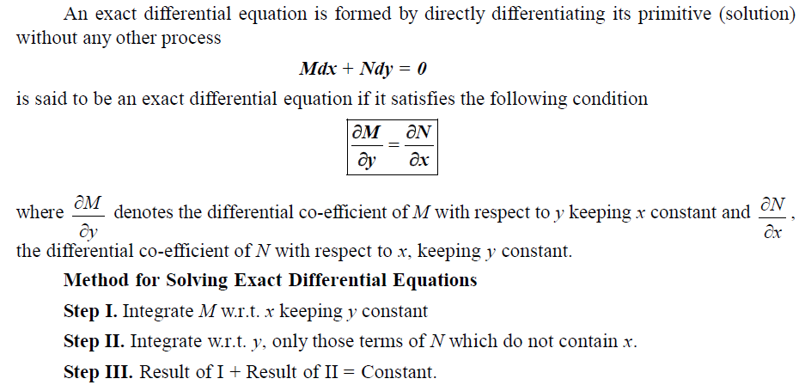
EXACT EQUATIONS
Notes:
In mathematics, a partial differential equation is an equation which imposes relations between the various partial derivatives of a multivariable function.
Dlm kalkulus , jika fungsi mempunyai derivatif separa pembezaannya adalah Biarkan M dan N berterusan dan mempunyai turunan separa pertama yang berterusan di rantau dalam satah xy yang sempadannya adalah lengkung tertutup tanpa persimpangan diri. Kemudian dengan pembezaan separa (4) (lihat App 3.2 untuk notasi),
We recall from calculus that if a function has continuous partial derivatives, its differential (also called its total differential) is
Let M and N be continuous and have continuous first partial derivatives in a region in the xy-plane whose boundary is a closed curve without self-intersections. Then by partial differentiation of (4) (see App. 3.2 for notation),

Slide 3
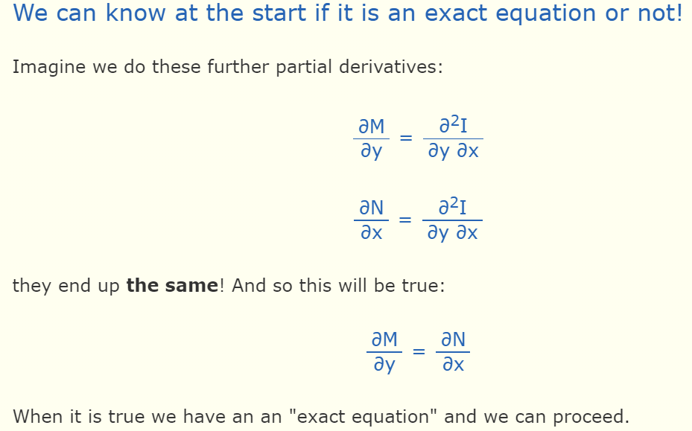
Determine Exact Equations
Notes:
Test of exactness A differential equation Mdx + Ndy=0 is exact if and only if dM/dy = dN/dx

Slide 4
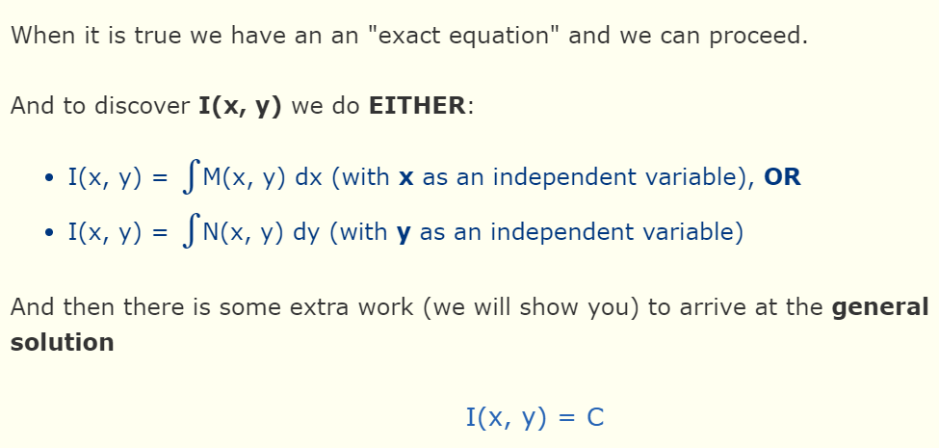
Notes:
Independent variable-a variable whose variation does not depend on that of another.

Slide 5
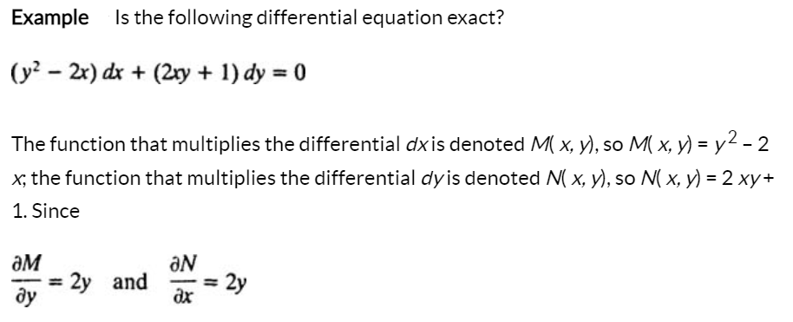
Solution of An Exact Equations

Slide 6
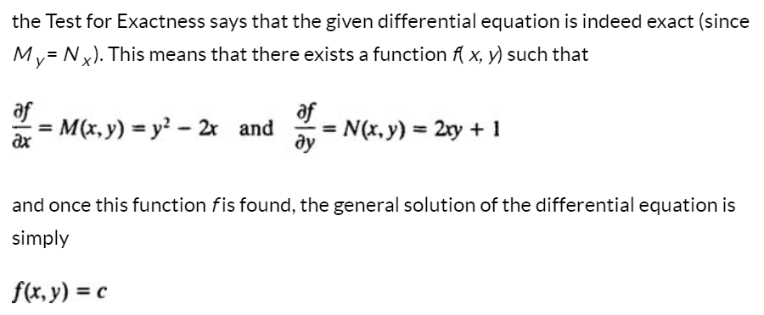
Notes:
Once a differential equation M dx + N dy = 0 is determined to be exact, the only task remaining is to find the function f ( x, y) such that f _{x} = M and f _{y} = N. The method is simple: Integrate M with respect to x, integrate N with respect to y, and then “merge” the two resulting expressions to construct the desired function f.

Slide 7
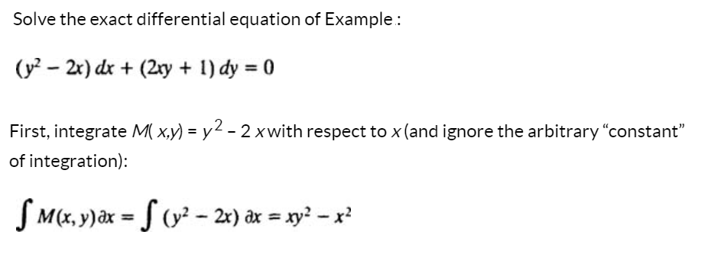
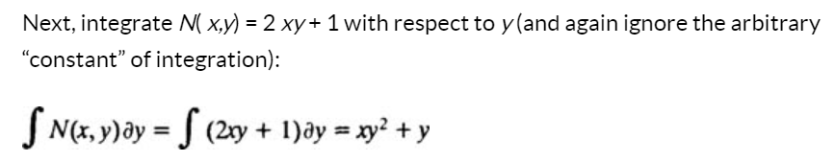

Slide 8
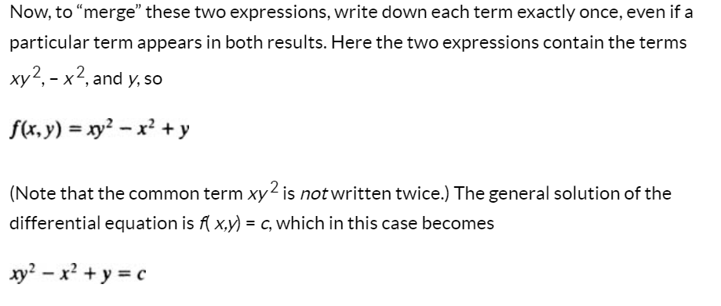

Slide 9
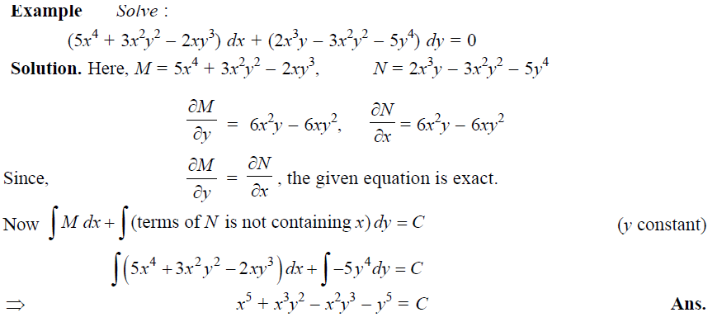
Example
Notes:
First, integrate M( x,y) = ……with respect to x (and ignore the arbitrary “constant” of integration):
Next, integrate N( x,y) = ….with respect to y (and again ignore the arbitrary “constant” of integration):
Now, to “merge” these two expressions,

Slide 10
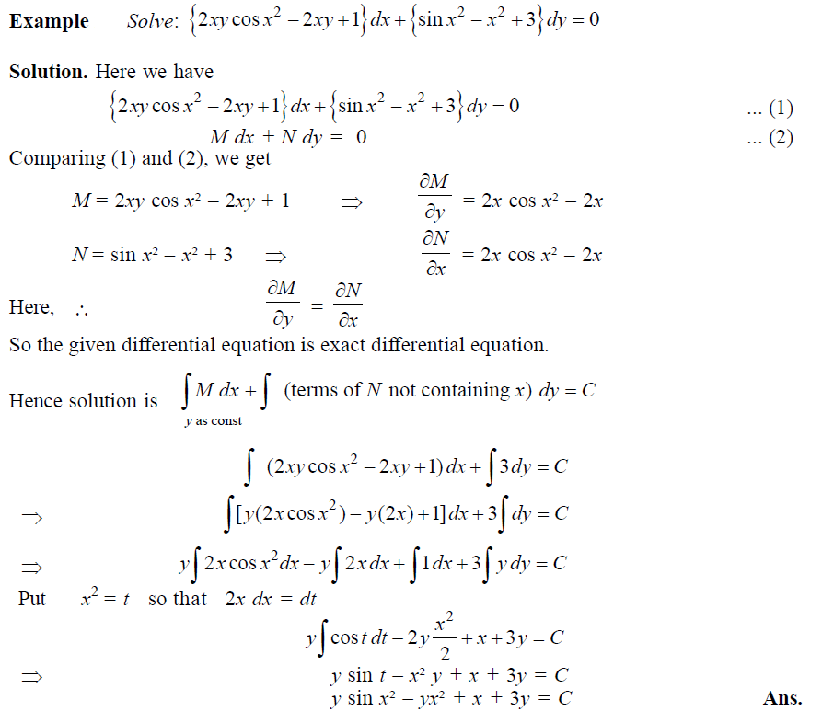
Example

Slide 11
THANK YOU

